Slide 1
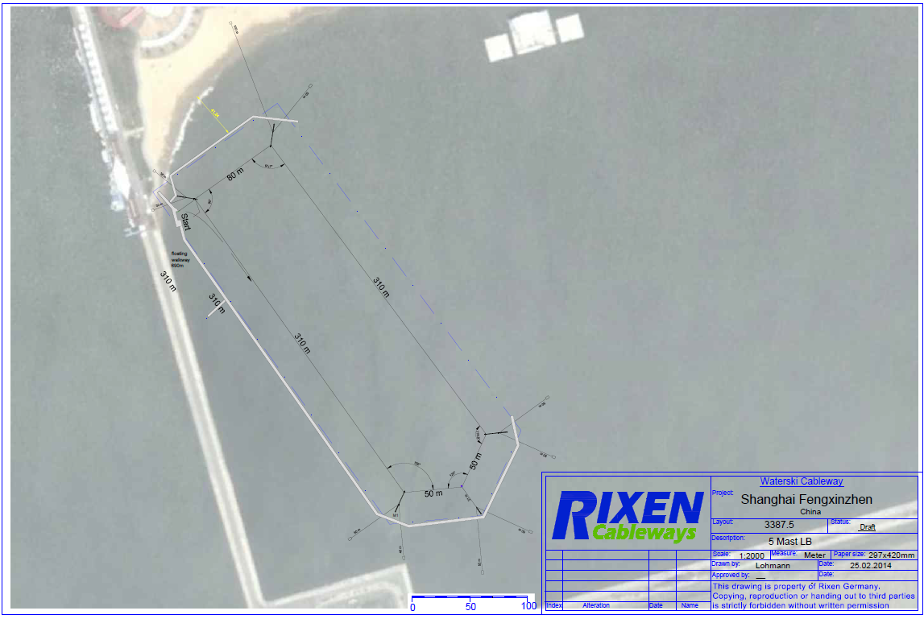

Slide 2
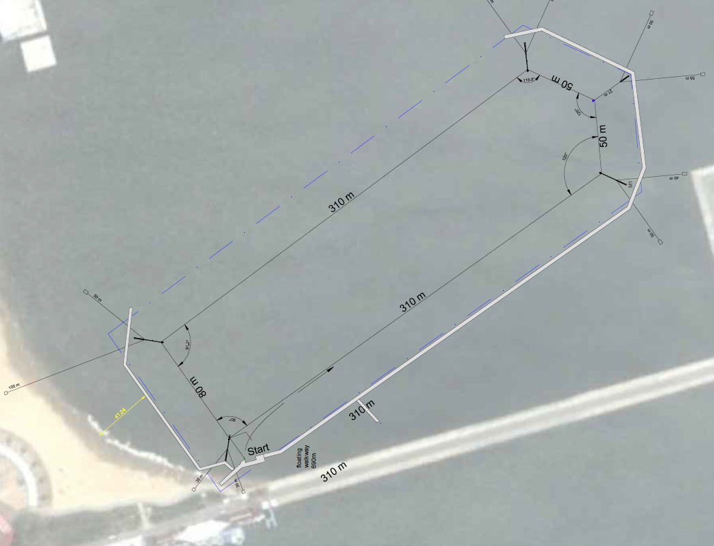
Video Position and Judges
Ramp
Obstacle free area
Obstacle free area
Little Bro

Slide 3
